Slide 1
WHAT IS IOT???
The Internet of Things (IoT) describes the network of physical objects—“things”—that are embedded with sensors, software, and other technologies for the purpose of connecting and exchanging data with other devices and systems over the internet.
OR
The internet of things, or IoT, is a system of interrelated computing devices, mechanical and digital machines, objects, animals or people that are provided with unique identifiers (UIDs) and the ability to transfer data over a network without requiring human-to-human or human-to-computer interaction.
OR
the Internet of Things is the concept of connecting any device (so long as it has an on/off switch) to the Internet and to other connected devices. The IoT is a giant network of connected things and people – all of which collect and share data about the way they are used and about the environment around them.

Slide 2
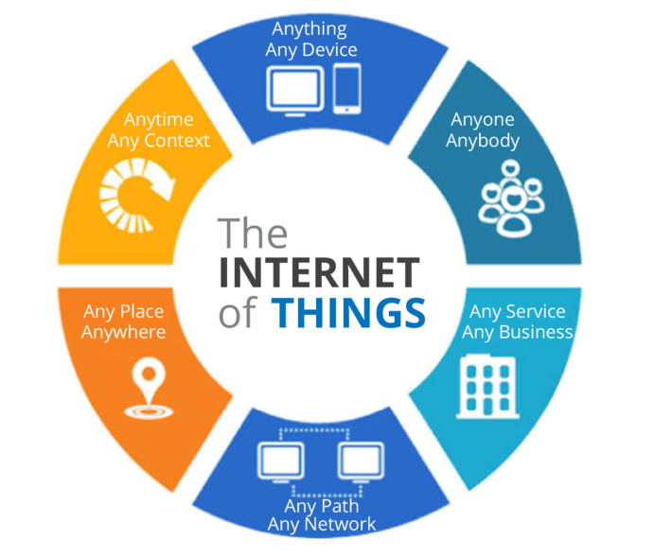

Slide 3
Components In IoT
Many Elements Make IoT Communication Possible, But Mainly It Consists Of The Following Components, Which Helps Devices Communicate Are:-
Sensors
Gateway
Cloud
Connectivity
User Interface

Slide 4
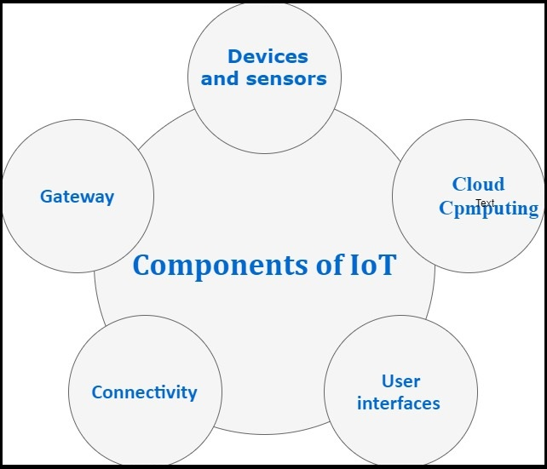

Slide 5
SENSORS:
The sensor may be defined as a machine, module, subsystem, or device whose purpose is to detect changes and events in the environment.
A sensor is a device that detects and responds to some type of input from the physical environment. The input can be light, heat, motion, moisture, pressure or any number of other environmental phenomena.
GATEWAY:
Gateway Suggests The Bridge Of Communication Between Two Devices. IoT Gateway Follows The Same Principle. It Is Also The Bridge Of Communication Between Devices/Sensors And The Internet(Connection Point Between Cloud And Controllers). The IoT gateway provides a certain level of security for the network and data transmitted with higher-order encryption techniques.
CLOUD:
Sensors In IoT Devices Collect Billions Of Data!! To Store And Secure The Data, Thus, Sensors Talk To The Cloud Through Connectivity. Cloud Allows Easy Access To Huge Data Whenever Required. Once Data Gets Into The Cloud, It Is Processed And The Required Action Is Performed. It provides tools for collecting, processing, and storing data. The data is easily available and accessible remotely through the internet.

Slide 6
CONNECTIVITY:
Connecting Is No Doubt An Essential Thing In IoT. Connecting Things To Sensors/Devices Has Many Options Like Bluetooth, Satellite, Cellular, Ethernet, Etc. If A Perfect Connection Is Establish Then The Power Consumption Of The Device Will Be Very Less And Bandwidth Will Be Huge.
USER INTERFACE:
This Is Essential For Users To Interact With Devices. As The Name Suggests, The User Uses Computer Applications, Software To Communicate With IoT Devices.

Slide 7
What are the pros and cons of IoT?
Some of the advantages of IoT include the following:
ability to access information from anywhere at any time on any device;
improved communication between connected electronic devices;
transferring data packets over a connected network saving time and money; and
automating tasks helping to improve the quality of a business's services and reducing the need for human intervention.
Some disadvantages of IoT include the following:
As the number of connected devices increases and more information is shared between devices, the potential that a hacker could steal confidential information also increases.
Enterprises may eventually have to deal with massive numbers -- maybe even millions -- of IoT devices, and collecting and managing the data from all those devices will be challenging.
If there's a bug in the system, it's likely that every connected device will become corrupted.

Slide 8
What is it Used For?
Smart Home Applications
Lighting, heating and air conditioning as well as media and security systems are all part of an IoT-enabled home. These can provide energy savings by turning of devices that are not needed. These are usually controlled from a smartphone, tablet or other device.
Transport Applications
The Internet of Things has numerous applications for transport, for example with inter-vehicular and intra-vehicular communication, smart traffic control, smart parking, toll collection, logistics, fleet management, vehicle control, safety and road assistance.
Disaster management
Internet of Things with wide range of smart sensors allow engineers to build a more effective emergency response system for factories, schools, hospitals, airports and any other public gathering places. Any emergency situations like fire outbreak or flooding will be automatically detected using sensors and this information is shared to responsible work groups in real time.

Slide 9
Industrial Applications
Industrial Iot (IIoT) devices allow for data from equipment, technologies and locations to be collected and analysed. The IIoT also allows for automated updates for assets to maintain efficiencies and prevent lost time and money for repairs and other situations.
Agriculture​ Applications
Agricultural IoT applications include data collection for weather conditions, soil content or pest infestation. The data can help automate farming techniques, inform decisions, improve safety, reduce waste and increase efficiency. Using artificial intelligence and specific computer programmes can improve everything from soil maintenance to fish farming.
Military Applications​
The application of IoT technologies for military purposes has created the Internet of Military Things (IoMT). Applications in this area include reconnaissance, surveillance, and more to deliver battlefield data. This can include the use of sensors, munitions, vehicles, robots and wearable technologies to create a joined-up and data efficient military.

Slide 10
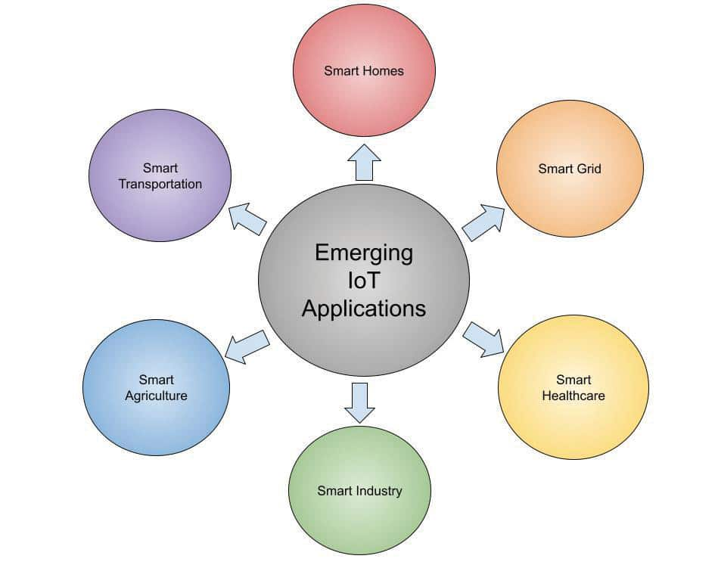
Healthcare: Wearable IoT devices provide a range of benefits to patients and healthcare providers alike. By extension, IoT enables healthcare professionals to monitor patients remotely. The devices can automatically collect patients’ health vitals like blood pressure, heart rate, temperature, and more.

Slide 11
SENSORS AND ACTUATORS
What are sensors?
Sensor is a device used for the conversion of physical events or characteristics into the electrical signals. This is a hardware device that takes the input from environment and gives to the system by converting it. For example, a thermometer takes the temperature as physical characteristic and then converts it into electrical signals for the system.
What are actuators?
Actuator is a device that converts the electrical signals into the physical events or characteristics. It takes the input from the system and gives output to the environment. For example, motors and heaters are some of the commonly used actuators.

Slide 12
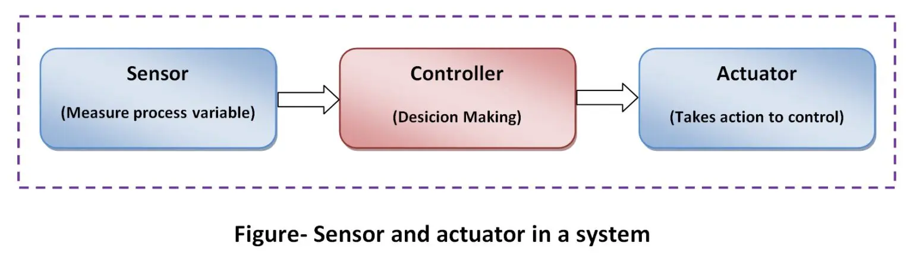
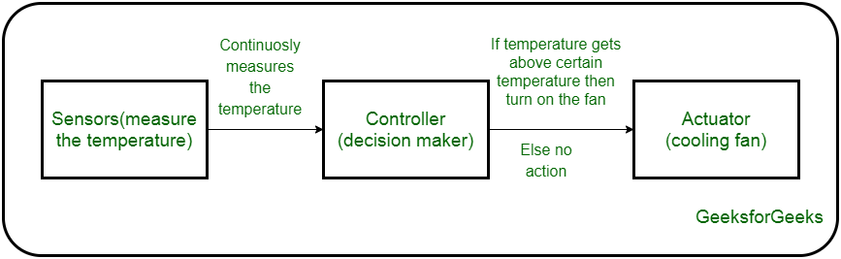
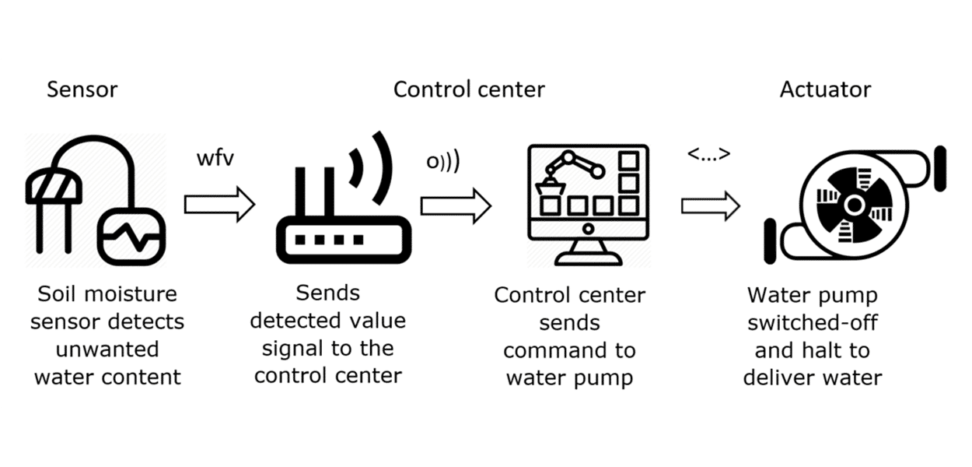

Slide 13
SENSOR | ACTUATOR
It converts physical characteristics into electrical signals. | It converts electrical signals into physical characteristics.
It takes input from environment. | It takes input from output conditioning unit of system.
It gives output to input conditioning unit of system. | It gives output to environment.
Sensor generated electrical signals. | Actuator generates heat or motion.
It is placed at input port of the system. | It is placed at output port of the system.
It is used to measure the physical quantity. | It is used to measure the continuous and discrete process parameters.
It gives information to the system about environment. | It accepts command to perform a function.

